Slide 1
Social accountability tools guide
How to integrate advocacy into the CCT process

Slide 2
Introduction
Church and community transformation (CCT) and CCT advocacy

Slide 3
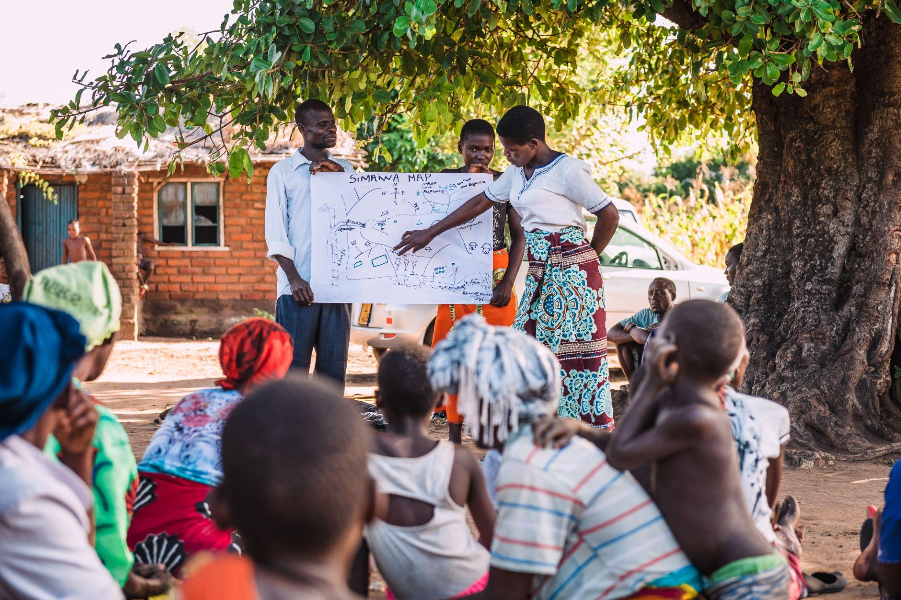
Church and community transformation
Tearfund believes that local churches – wherever they are in the world – begin a lifelong journey when they embrace and commit to living out a theology of what we call ‘integral mission’.
This journey empowers them, changes mindsets and brings about holistic transformation in both the church and the community.
Notes:
Alex Baker/Tearfund

Slide 4
Church and community transformation
The ultimate goal of this journey is to see broken relationships restored.
The church seeks ‘whole-life’ change, and responds in a comprehensive way to the needs of their local community.
Overcoming poverty in the community is approached holistically and from within, as people realise their potential and recognise the resources God has given them.
We refer to the destination of that journey as ‘church and community transformation’ (CCT)*.
Notes:
*If you have good internet access you can download and play the short video that explains CCT instead of using this slide: https://www.youtube.com/watch?v=v4sUoJHZkH4
A link to An introduction to church and community transformation (CCT) - Tearfund Learn

Slide 5
Integrating advocacy into CCT
Integrating advocacy into CCT strengthens the outcomes and ultimately contributes to the vision of ‘whole-life’ change.
Church and community transformation advocacy integrates this advocacy into CCT using social accountability tools.
This approach uses advocacy strategies and actions that lead to ‘good governance and responsive and transparent service delivery by governments’.
+
=
Notes:
https://player.vimeo.com/video/229535462 CCMP Advocacy

Slide 6
Introduction
What is social accountability?

Slide 7
What is social accountability?
What: Social accountability is defined as ‘the extent and capacity of citizens to hold the state and service providers accountable and make them responsive to the needs of citizens and beneficiaries’.
Who: Citizens, communities, the church, independent media and other organisations can all use social accountability tools at both local and national levels.
Why: to influence the quality of service delivery, by holding accountable service providers such as public officials and public servants.
The goal of social accountability is not to replace but to reinforce and complement existing accountability processes.
Notes:
Alex Baker/Tearfund

Slide 8
Biblical basis for social accountability
We serve a God of justice. As Christians, we are also required to ‘act justly’ (Micah 6:8).
To do justice requires:
accountability
people to be responsible for fulfilling their duties and obligations to others
Advocacy promotes mutual accountability between the individual and others like the government.

Slide 9
Exercise: What do the passages teach?
Spend some time in small groups reading and reflecting on:
Proverbs 31:8-9
Jeremiah 22:3
Deuteronomy 25:13-16
Psalm 82:3
Read Ezra 8:28-34 in groups
Which three areas of accountability are demonstrated by the men in the passage?

Slide 10
Three areas of accountability
Accountability to God: Identify different ways in which you show dependence upon God, especially in challenging circumstances.
Accountability to self: How does your daily work reflect God’s purpose for your life?
Accountability to others: What activities can you introduce in your church for members to experience greater connectedness?
Notes:
Find full bible study here: https://learn.tearfund.org/en/resources/footsteps/footsteps-71-80/footsteps-76/bible-studynbspbiblical-accountability-nbsp

Slide 11
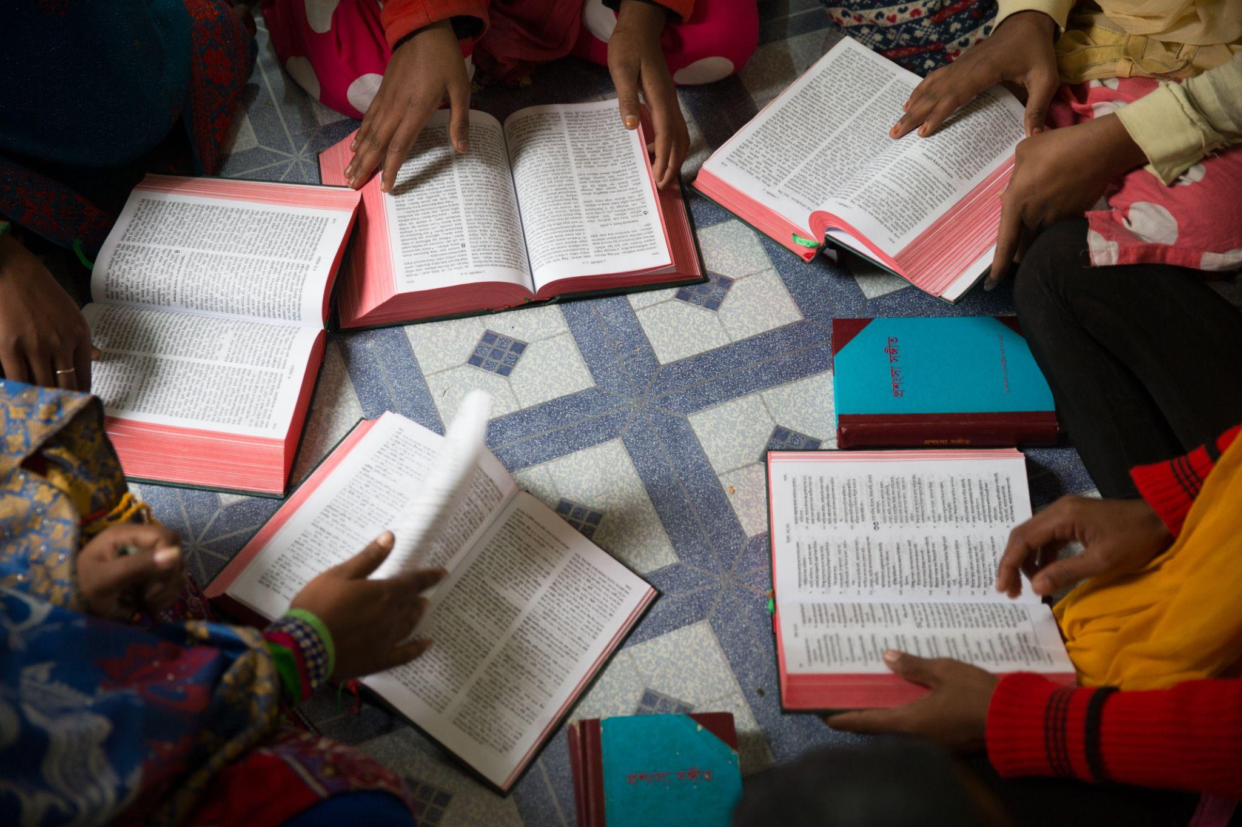
Biblical basis for social accountability
God has placed Christians in many different areas of work and society, all of which need to be influenced and transformed if poverty is to be alleviated. Christians need to use their strategic influence by following the biblical example:
Speaking out against injustice and idolatry
Modelling an alternative society, showing how God intended it to be
Confronting authority when it goes against what the Bible teaches
Praying for God to intervene
Bringing peace and reconciliation
Seeking social and economic justice

Slide 12
Social accountability tools
What do we need to keep in mind to increase the effectiveness and chance of success of the social accountability tools?
(Discuss in pairs)

Slide 13
Main goals of social accountability tools
To enable citizens to directly engage with state institutions – to influence policies and monitor functions.
To be an effective way of collecting, analysing and passing on information.
To provide opportunities to mobilise public support for community development projects.
To facilitate advocacy and negotiation for changes or improvements to service delivery.
To help citizens and communities to understand the accountability processes at different levels of government.
To enhance citizen or civil society organisation (CSO) participation in the ‘internal’ government process of accountability.

Slide 14
Factors to keep in mind
For the successful, effective use of social accountability tools:
Have a good understanding of the social and political context.
Take time to understand the structure of public finance at local, regional and national levels.
Follow the CCT approach of identifying and prioritising needs to ensure sensitivity to people in the community.
Support the community to identify a group (called ‘social accountability champions’ in some contexts) to lead the process.
Ensure other community members understand the process and provide regular feedback to ensure maximum participation.
Secure the commitment of the service provider(s) from the beginning.
Put together a plan for coordinated follow up.

Slide 15
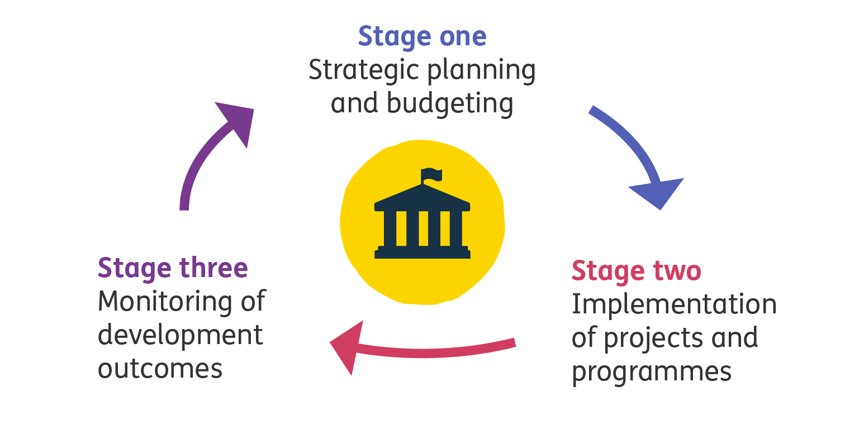
A generic government development cycle
There are three main stages represented in any government’s development cycle.
Some governments may separate the tasks and have more stages.
Quick plenary discussion:
What is happening at each stage?
Can you give some practical examples?
Notes:
Ask the participants

Slide 16
Using the tools within a government development cycle
Group exercise:
Which tool(s) can be used at each stage of the development cycle?
Share the reasons for your choices.
Notes:
Note to Facilitator: Exercise
What you will need:
An open space
3 sheets of paper with the names of the development cycle stages written/printed on them
Sheets of paper with each social accountability tools printed/written on them (a full set for each group)
Running the exercise: Print/write out the names of the development cycle stages on different sheets of paper. Do the same with the Social Accountability tools, with a full set of tools available for each group. Using an open space, place the pieces of paper with the development cycle stages in different parts of the room/area. Put participants in groups, giving each a full set of the tools. The groups must then place each tool on the development stage where they believe the tool should be used in the shortest possible time.
Once all the groups have completed the task, ask them to take it in turns to feedback on why they placed the tools where they did.

Slide 17
Answers: using the tools within a government development cycle
Stages of a government development cycle | Stage one: Monitor and influence the strategic planning and budgeting | Stage two: Monitor implementation of projects and programmes | Stage three: Monitor the development outcomes
Key question being answered | Are the plans developed and funds allocated adequate to achieve set goals? | Are projects/activities being carried out according to desired quality, plan and budget? | Are the projects and activities implemented helping us reach the desired goals/outcomes?
Social accountability tools to be used, available in this guide | Participatory planning process | Budget tracking | Budget tracking
 | Budget tracking | Citizen journalism | Citizen journalism
 | Citizen journalism | Community scorecards | Community scorecards
 | Community scorecards | Public expenditure tracking surveys | Social audit
 |  | Social audit

Slide 18
Using the tools within a government development cycle
Social accountability tools are extremely effective when they:
become established and linked to the various structures of governance involved in service delivery
are put in place at the correct stage of the government development cycle
The majority of the social accountability tools focus on the first two stages, as they are foundational in achieving positive outcomes.
Notes:
See the CIVICUS Participatory Governance Toolkit for in-depth reading.

Slide 19
Participatory planning process tool
Tool 1

Slide 20
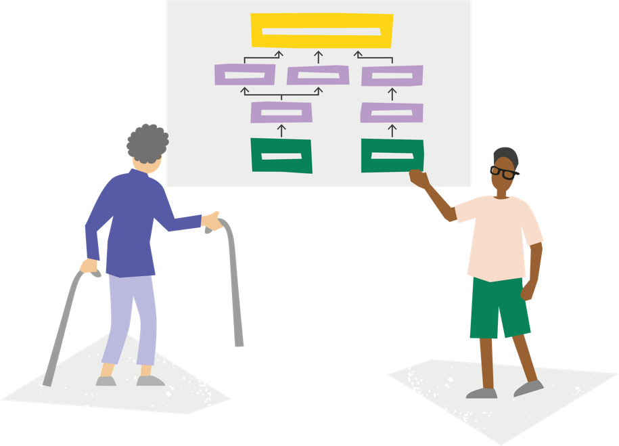
Tool 1: What is the participatory planning process tool?
Participatory planning is a process by which citizens show their influence and control over development initiatives which affect them. Playing an active role in:
setting priorities
allocating resources
monitoring the outworking of development initiatives
The term ‘participation’ can be used to mean various processes such as:
information-sharing
consultation
collaborative planning (*we aim for this)

Slide 21
Tool 1: Purpose
This tool is aimed at supporting local churches and communities’ efforts to do the following:
Ensure local knowledge and understanding are incorporated in government development plans and initiatives.
Ensure communities actively participate in the making of development decisions that may affect them
Ensure that development interventions are appropriate to the needs and preferences of the communities they are intended to benefit.

Slide 22
Tool 1: Strengths
Group exercise / Discussion in pairs:
What are the advantages of using the participatory planning process tool?

Slide 23
Tool 1: Strengths/advantages
It increases citizens' voices
Citizens are well informed
They have opportunities to participate in identifying development needs and in deciding what policies and programs of their local governments should be prioritised.
It opens up new civic spaces for citizens to exact performance, transparency and accountability from their local governments. Citizens to be involved not only in the implementation of the plans but also in monitoring and evaluating the performance of their local governments.
It builds community ownership in local government plans, which in turn, opens access to community resources, for example resources identified during the church and community mobilisation processes.
It helps shift the power dynamics between different forms of power, stakeholders and resources thereby enabling different participants to interact in an equitable and genuinely collaborative way.

Slide 24
Tool 1: Limitations
Group exercise / Discussion in pairs:
What are the limitations of using the participatory planning process tool?

Slide 25
Tool 1: Some limitations
It may not directly lead to community involvement in the actual outworking, monitoring or evaluation of actions.
The process could be captured by community elites or other powerful people and organisations as they seek to promote their own interests by manipulating the process.
It requires time and resources to include various stakeholders with diverse interests.
It raises expectations.
Notes:
It may not directly lead to community involvement in the actual outworking, monitoring or evaluation of actions. Even in the presence of supportive legal frameworks, there may not be the right environment for this involvement. For example, there may not be a culture that encourages interaction between citizens and the government, or an informed and engaged community, or the political support.
The process could be captured by community elites or other powerful people and organisations as they seek to promote their own interests by manipulating the process.
It requires time and resources to include various stakeholders with diverse interests.
It raises expectations. Asking for input from multiple stakeholders into the policy making and planning process is likely to raise their expectations of having their views taken into account; this is not always possible and these limitations need to be clearly spelled out from the beginning.

Slide 26
Using and adapting the tool
Tool 1

Slide 27
Tool 1: Planning in your CCT process
CCT approach | CCMP | Umoja/Parivartan/Unidos | Sangsangai
How and when is planning done in your CCT process?
How are the identified issues prioritised?
When can participatory planning can be introduced?
Notes:
Note to Facilitator: Create groups based on the CCT process the participants use. If they use one common process, agree on the stages in the CCT process before assigning people to groups to set out how they go about the planning process and how the issues to focus on as a church and community are agreed upon.

Slide 28
Tool 1: Planning in your CCT process (summary)
CCT approach | CCMP | Umoja/Parivartan/Unidos | Sangsangai
When participatory planning can be introduced | Stage 4: Information analysis Stage 5: Decision making | Stage 3: Dreaming dreams and taking action (planning for action) Stage 4: Taking action | 3rd cycle: The community
A common feature of all CCT processes is that they all use the participatory method, so they are well set up to incorporate participatory planning. Therefore much of the work described in the participatory planning tool will have been done by the church and community if they have done stages 3 and 4 of the CCT process.
Notes:
Note to Facilitator: Conclude the exercise by reminding the participants of how participatory CCT processes are

Slide 29
Using the tool: Key steps in the participatory planning process
In a regular participatory planning process, the following steps are taken:
Verbal ranking of problems and opportunities (done in stages 3 and 4 of CCT processes)
Community action plan (similar to the planning and decision-making stages in CCT approaches)
Mapping of existing opportunities: This is the new part! From the list of identified issues, pick out those that can be incorporated into government plans and budgets
Notes:
Note to facilitator: Using the information collected in the CCT process exercise on slide 27/28
Somethings to consider when completing step 3:
a. Do background research: Find out what laws and policies there are in your country relating to citizen participation in government planning processes.
b. Build relationships: It is very important to try to build relationships with people in the relevant government department or local authority, as well as with community leaders.
c. Agree on the issue(s) that need to be included in the government plan and budget: This is based on the priorities and resources identified during the CCT problem identification and prioritisation exercise. Not all issues will be incorporated into the government plan as some of them will be addressed by the community using its own resources in line with CCT principles.
d. Gather the information you need: Try to get hold of the local authority guidelines for planning and community participation to establish if there is a legal framework supporting citizen participation, and to understand what government planning platforms exist (including key dates in the planning process). Once you have received all the Social accountability tools guide 28 documents, read them carefully. Don’t worry if you have questions about things you don’t understand – it is fine to ask the people in the office or authority who provided the information.
e. Develop a strategy: Depending on the responses given in the participatory planning tool, agreement will be reached on how to engage with the government planning process to ensure the community priorities find their way into the final government plans and budgets. This will include agreeing on who should do what.

Slide 30
Preparing for the community meeting
Community meeting facilitator background research: to get a basic understanding of the country’s local and national planning cycles to build your confidence on the subject.
Facilitator/community research: research with the community to acquire a more detailed understanding of the planning processes in their local area.
Key questions to be answered:
Is there a law that supports participatory planning?
When is the beginning and end of the fiscal year?
How is annual planning done in the country at local and national level?
What platforms are available to input into the local or national plans?
Who leads the planning process?
What are the key dates, eg start and end dates of consultation periods?

Slide 31
Using the tool: Testing the template
Facilitators group prepare for community meeting
Read the case study to understand the community context
Read through the tool to understand the requirements and simplify the information in the tool, if necessary.
Agree on how the community meeting will be conducted
Different members should take turns to lead the community meeting
Church and community group
Read the case study to understand the community context
Agree as a community on the key dates for your government planning process?
In what months of the year does the planning process begin?
When do consultations start and end?
When will the final government plan and budget be ready?
Notes:
Note to facilitator: The testing of the template can be done through role play with two (2) main roles, the Facilitators group and the Church & Community group. Depending on the number of participants, each group must have between 3 to 6 people. Hand out copies of the participatory planning template to the Facilitator group and copies of the case study to the Church and Community group.
You will need:
Printouts of the template
Printouts of the case study - available in 4 TF core languages

Slide 32
Using the tool: Testing the template
Feedback session
Feedback from the audience
What did you like about the role-play?
What can be improved?
Church and community group
How did you find the exercise?
Anything the facilitators could have done differently to help you as a group?
Facilitators group
How did you find your role?
Anything that was challenging to do?
Everyone
How would you go about facilitating this session if your community cannot read? Give some ideas from your experiences.
Notes:
Note to facilitator: This reflection session will help you see if the participants are understanding the material. Extra resources have been provided in the Guide under “Further Guidance” that facilitators can use as they do their background reading and research

Slide 33
Further reading
Advocacy in Nepal: Community participation in government planning
2.1.4 Participatory planning methods and tools used
Participatory Development Planning

Slide 34
Budget tracking tool
Tool 2

Slide 35
Tool 2: What is the budget tracking tool?
This tool is used for the monitoring of government spending, by citizens, communities and other interested stakeholders through the review and periodic analysis of the budget. Budget tracking involves conducting:
Reviews: Looking at the allocations of funds and establishing whether or not the funds have been allocated to the correct sectors.
Budget analysis: Looking at what was allocated at the beginning of the fiscal year and tracking what has been released and spent. Answering the question: ‘Is this leading us towards the intended development outcome?’

Slide 36
Tool 2: Purpose
To monitor the allocation of money to ensure that the funds are correctly distributed, being released on time and being spent according to the plan (budget).
This tool can be used at all levels of government where budgeting or expenditure takes place.

Slide 37
Tool 2: Strengths
Group exercise / Discussion in pairs:
What are the advantages of using the budget tracking tool?

Slide 38
Tool 2: Strengths
It supports the effective implementation of set budgets: the budget reflects the ‘choices that the governments make to realise their socio-economic agenda. Thus, how effectively the budget is implemented is indicative of the extent to which policy is translated into outcomes.’
Improved service delivery can come about as budgets are used where needed instead of delayed or diverted.
It has the potential to reduce and expose corruption, crime and misapplication of resources as citizens notice when funds do not reach their intended destination.

Slide 39
Tool 2: Limitations
Those most impacted by decisions may not have opportunity to participate in the process: the choices about where resources are used can be biased by personal opinions or needs. There might also be political motives at work. Those who are most likely to be impacted may not have political or economic power, leaving them unable to participate in the budget formulation process.
There is no guarantee that resources budgeted for will be raised and be available to fund the various programmes.
The tool is more difficult to use in a centralised system of government.

Slide 40
Using and adapting the tool
Tool 2

Slide 41
Tool 2: Budgeting in your CCT process
CCT approach | CCMP | Umoja/Parivartan/Unidos | Sangsangai
When can the budget tracking tool can be introduced?
Notes:
Note to Facilitator: Using the CCT stages agreed in the earlier exercise with the participants. If they use one common process, agree on the stages in the CCT process before assigning people to groups to set out how they go about the planning process and how the issues to focus on as a church and community are agreed upon.

Slide 42
Tool 2: Budgeting in your CCT process (summary)
Ideal for use at the stage where resource mapping has been done
When community is clear on the problems for which tracking the government budget will be useful.
CCT approach | CCMP | Umoja/Parivartan/Unidos | Sangsangai
When the budget tracking tool can be introduced | Stage 4: Information analysis | Stage 3: Dreaming dreams and taking action (planning for action) Stage 4: Taking action | 3rd cycle: The community

Slide 43
Tool 2:
Processes and tools for budget tracking

Slide 44
Budget legal framework
Every country, like every family, has a legal framework which outlines:
the political process that the budget needs to follow
defines the key actors and their roles and responsibilities
the format and content of various budget documents
Countries have many laws and regulations that govern budget design, approval, implementation and evaluation processes. Examples of laws:
Constitution
Public Finance Management Act
Public Audit Act
Procurement Act
Notes:
Notes to facilitator: You can make the judgement call if it is necessary for your participants to interact with this information in detail. If yes, they can set out some of the laws in their Country.

Slide 45
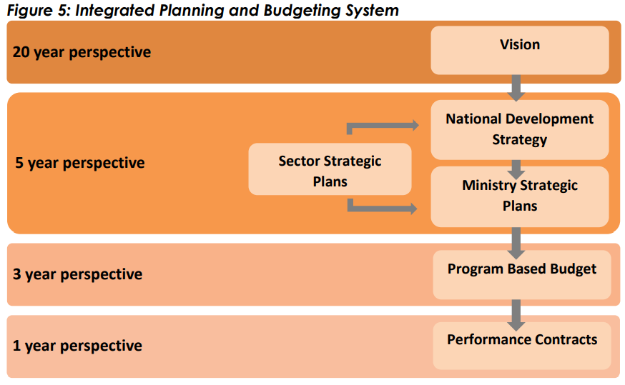
Malawi policy and budget calendar
Notes:
This example of the Malawi Policy and Budget Cycle demonstrates how the different plans contribute to the achievement of national goals and visions. Main lesson: You have to get on the RIGHT BUS to arrive at the RIGHT DESTINATION-If the annual plans are not implemented well, it will be impossible to achieve the more long term goals set out in national developments (e.g. 5 year plan, 20 year plan)

Slide 46
Generic budget cycle
1
Budget formulation
The executive formulates the draft budget. Key budget documents include executive's budget proposal, supporting budget reports.
4
Budget oversight
The budget accounts are audited and audit findings are reviewed by the legislature, which requires action to be taken by the executive to correct audit findings. Key documents include audit reports, legislative audit committee reports.
2
Budget approval
The legislature reviews ad amends the budget - and then enacts it into law. Key budget documents include budget law, reports of legislative budget committees.
3
Budget execution
The executive collects revenue and spends money as per the allocations made in the budget law. Key budget documents include in-year reports, mid-year reports, supplementary budgets.

Slide 47
Tool 2: Budget tracking exercise
Group exercise
(Group 1, 2 and 3)
Indicate months of the financial year when the four key processes take place.
(Also indicate if it is an ‘ongoing’ process)
Notes:
Note: The participants work in groups to put the dates when the processes in the budget cycle take place. You have agree if they are indicating the dates for the local, subnational or national level processes. This will depend one who you are training-church and community, national partners, etc.

Slide 48
Using the tool: Family budgeting activity
Family name and occupations | Number of children | Total income | Assets
The Mwales Doctor and company executive director | 4 | 80,000 | 3 vehicles Own their home
The Smiths Teacher and bank teller | 3 | 20,000 | 1 vehicle Rented home
The Koffis House help and labourer | 4 | 700 and unknown amounts depending on what is earned on the day | 1 bicycle Rented home
Mr Keita (Single man) Mechanic | 0 | 5000 | Renting a bedsit
Notes:
Note for Facilitator follow the instructions on pages 49 and 50 of the guide, as well as below:
Every family plans and budgets, some plan by faith as they are never sure how much money they will have. As the facilitator:
Using the table above, assign participants to the into groups of ‘families’.
Ask each family group to create a budget for the month.
Each family then presents its budget to the group, explaining the rationale for their choices and decisions.
Lead a conversation to help participants think through the kind of items being budgeted for.
Discuss the differences in priorities between families, if any.
Discuss what happens if the money is not spent according to the budget for each family. For example, imagine Mr Koffi spends the 700 on alcohol. What would be the impact on the family during that month? Or if the Mwale family contributes 5,000 to a family wedding?

Slide 49
Using the tool: Key steps in the budget tracking process
Form a budget tracking team: If possible, the team should be elected by the community. Teams vary in size, but usually have between nine and 14 members. It should include women and men, and people of different ages, ethnic groups and status within the community.
Background research: What laws and policies there are in your country relating to budget transparency. For example, there may be laws that say people are free to access information regarding budgets.
Build relationships: with people in the relevant government department or local authority, and with community leaders.
Agree on the issue to monitor based on the priorities set during the CCT problem identification and prioritisation exercise.
Gather the budget information you need using the budget tracking template.
Find out what is actually happening: Is the budget being spent as it should be?
Analyse all of the information: Does it all add up?
Feedback to your community and decide on how to follow up. Collect all your information and hold a community meeting to make sure everyone has the opportunity to hear your findings, and to be involved in any follow up.

Slide 50
Example of budget tracking tool
BUDGET MONITORING IN ZAMBIA

Slide 51
What to look for in a budget
The budget allocation as a percentage of the whole budget to show priorities
Budget allocation / Total budget x 100 = Budget share (%)
Rate of increase
(Later year - Earlier year) / Earlier year x 100 =Percentage increase (%)
The role of inflation:
Compare trends in allocations over time
Failure to take account of inflation will impact on service delivery
Goods and services will be more expensive next year than this year
A budget allocation would have to increase to deliver the same service over a number of years

Slide 52
Budget analysis
Notes:
Note to Facilitator: This is an exercise to help the participants practice how to right simple recommendations based on their findings. Work through one key message with them agreeing on how to frame the Recommendation. Give each group a key message and ask them to design their Recommendation.

Slide 53
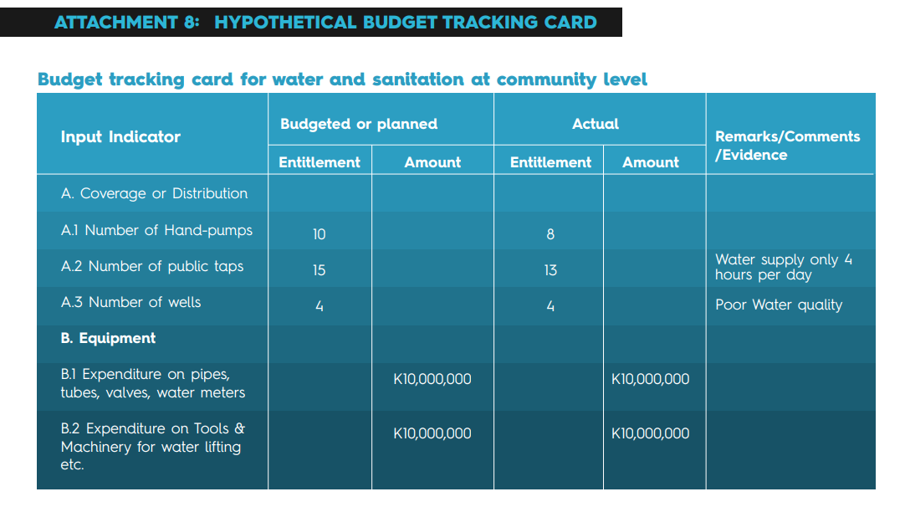

Slide 54
Tool 2: Case study – Bolivia
Can anyone remember what the case study was about?
Advocacy in Bolivia

Slide 55
Further guidance
Build your confidence on the subject.
Research with the community to acquire a more detailed understanding of the budgeting processes in their local area.
Key questions to be answered:
When are budgets approved in the country at local and national level?
What form of government is in place? Centralised or decentralised form of government?
What resources are sent to the local level?
In what ways can budget information be accessed?
What are the key dates for budget allocations, disbursements and reporting?

Slide 56
Further reading
Monitoring government spending (budget tracking)
Budget tracking for beginners: An introductory guide
Manual on Social Accountability: Concepts and Tools. Pages 52 to 80 explain budget tracking in depth.
Just and Democratic Local Governance: Budgets
Kenya County Budget Training Workshop Materials for Facilitators and Participants

Slide 57
Citizen journalism tool
Tool 3

Slide 58
Tool 3: What is the citizen journalism tool?
Citizen journalism is the action of ordinary citizens without journalistic experience creating stories intended for their chosen audience using a cell phone with a camera and sound recorder, and sharing it with their community or the world using social and traditional media.
The stories created by citizen journalists often represent communities and issues overlooked by traditional media. Citizen journalism:
can be done by any citizen
addresses stories not covered in the main news
gives citizens an opportunity to be active people
with voices
gives an opportunity for citizens to collect, analyse and report information to an audience

Slide 59
Tool 3: Purpose
To provide an essential representation of marginalised groups in media dark areas and enhance the local community’s social and cultural cohesion.
This tool can be used at all levels of governance where there is a demand side (citizens) and supply side (government).

Slide 60
Tool 3: Strengths
Promotes freedom of expression and citizen interests: Stories created by citizen journalists reflect what is going on in local communities. Citizen journalism functions as ‘an alternative news channel for reporting on politically sensitive information and facilitating the development of an online public sphere, therefore, enabling ordinary citizens to make their voices heard.’
Becomes a bridge between citizens and policymakers: Once citizen journalists are adequately trained they can become reliable sources of information for their communities, bridging this gap.
Fact checking: This tool can play an important role in identifying and verifying information in chaotic situations.
The tools used by citizen journalists are less expensive, efficient, and easy to operate.

Slide 61
Tool 3: Limitations
The most impacted may never have their stories heard: In some cases citizen journalists have limited audiences.
Politicians, journalists, citizens, and scholars may only accept what they believe or feel is true based on emotional drive or interest. This itself is an ethical challenge for journalistic activities in producing news in the post-truth era.
It may not support self-regulation or keep to ethical standards: This could also lead to the spread of misinformation.
It could lead to threats against the individual: There may be risks to the physical safety (assault, kidnapping, imprisonment, or extra-judicial killing) or digital safety (online harassment, surveillance, a lack of safe and secure communication) of the citizen journalist.

Slide 62
Tool 3: Citizen journalism in your CCT process
CCT approach | CCMP | Umoja/Parivartan/Unidos | Sangsangai
Notes:
Note to Facilitator: Create groups based on the CCT process the participants use. If they use one common process, agree on the stages in the CCT process before assigning people to groups to set out how they go about the planning process and how the issues to focus on as a church and community are agreed upon.

Slide 63
Tool 3: Citizen journalism in your CCT process (summary)
This tool is ideal for use at the stage where the communities, with the church, have conducted their needs assessment, identified the problems and opportunities in their communities, and are mobilising resources to address the problems. If some of the problems identified and prioritised have to do with government service delivery, this tool can be used to gather the evidence on the extent of the problem, create awareness of the problem in the community and even seek answers from those responsible on what they are doing to address the problem.
CCT approach | CCMP | Umoja/Parivartan/Unidos | Sangsangai
When citizen journalism tool can be introduced | Stage 2: Church and community description Stage 3: Information gathering Stage 4: Information analysis Stage 5: Decision making | Stage 2: Envisioning the community Stage 3: Dreaming dreams and taking action (planning for action) Stage 4: Taking action | 3rd cycle: The community

Slide 64
Tool 3: Key steps in citizen journalism process
Pick the issue of interest based on the community mapping done during CCT. This will ensure that the story has community backing and will provide a level of protection for the citizen journalist (see physical and digital safety in ‘limitations’ above).
Research and be clear about your rights as a citizen journalist: Some key questions to ask as you consider using this tool would be:
Is there a right to information law?
Are there any other laws that can support the capturing of the information we need in the format we want such as capturing video footage?

Slide 65
Tool 3: Key steps in citizen journalism process
3. Be a responsible citizen journalist operating within ethical guidelines:
Be accurate
Avoid plagiarism
Respect people’s right to privacy
Understand the contextual sensitivities of a community or the people involved
Ask for necessary permissions (eg to capture video or audio footage, take pictures, use names or other identifying information)
4. Set out your story
5. Think through the dissemination channels and be creative (see ideas in the template in the annex)

Slide 66
Tool 3: Exercise – Create a mock story
Agree on an issue to cover as a group
Set out your story:
What is happening / has happened?
Who, where, and when?
Why is it happening / has it happened?
How is it affecting people and why is this important?
What needs to happen now?
Who can help address the problem and are they aware of the problem?
Think through the dissemination channels and be creative (see ideas in the template in the annex)
Notes:
The groups will then make presentations of their stories and the other participants will give feedback

Slide 67
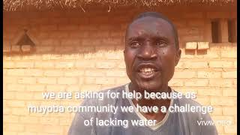
Tool 3: Case study – Zambia

Slide 68
Further guidance
As you plan to support the specific church and community to use this tool, you need to do some background work to get a basic understanding of the local socio-political governance context and establish if it allows for the use of such a tool.
Do some basic research on the media landscape in the community:
Is there a right to information law? Or any other laws that can support the capturing of information?
Is there a community radio station?
Is the community radio station willing to partner with citizen journalists to take up the stories?
Are they willing to conduct some of the training sessions to teach the citizen journalists?
Have a mix of citizen journalists so you have people who are able to read and write in the local languages as well as in the official language.

Slide 69
Further reading
Participation guide: Citizen Journalist
Service-Learning Guide for Citizen Journalists
Citizen journalism
Citizen Journalism Guidelines
Media Literacy: Citizen Journalists
Advocacy and social accountability toolbox
Local media survival guide
Citizen journalism practice
Female Zambian citizen journalists

Slide 70
Community scorecards tool
Tool 4

Slide 71
Tool 4: What is the community scorecard tool?
A Citizen-driven accountability tool
It facilitates monitoring and evaluating the performance of services, projects and even government administrative units (eg district offices) by the local community themselves.

Slide 72
Tool 4: Purpose
To promote transparency, efficiency and quality in the delivery of public services to communities by:
tracking the availability of services
monitoring of the quality of services or projects
comparison of performance across facilities or districts
generating a direct feedback mechanism between service providers and users
building local capacity
strengthening citizen voices and community empowerment
This tool is designed for use at a local level, especially monitoring specific facilities, eg clinics, schools or utility companies.

Slide 73
Tool 4: Strengths
Promotes common understanding through direct dialogue between citizens and service providers.
Increases joint responsibility between service providers and citizens, as citizens are more engaged in a participatory process to deliver quality and efficient services.
Allows for agile management of public projects.
Relatively easy to use and flexible in application.

Slide 74
Tool 4: Limitations
Local government officials may not be receptive to citizen participation and may be threatened by citizen feedback.
Local government officials may have limited capacity to implement citizen feedback.
Requires an excellent facilitator between citizens and local government to ensure all stakeholders are actively engaged and conflicts are amicably resolved.
Can create unrealistically high expectations

Slide 75
Tool 4: Community scorecards in your CCT process
CCT approach | CCMP | Umoja/Parivartan/Unidos | Sangsangai
Notes:
Note to Facilitator: Create groups based on the CCT process the participants use. If they use one common process, agree on the stages in the CCT process before assigning people to groups to set out how they go about the planning process and how the issues to focus on as a church and community are agreed upon.

Slide 76
Tool 4: Community scorecards in your CCT process (summary)
This tool is ideal for use at the stage where the communities, with the church is already experiencing a mindset shift, recognising their own agency. They also have a map of their resources and have identified areas of need.
CCT approach | CCMP | Umoja/Parivartan/Unidos | Sangsangai
When the community scorecard tool can be introduced | Stage 3: Information gathering Stage 4: Information analysis Stage 5: Decision making | Stage 3: Dreaming dreams and taking action (planning for action) Stage 4: Taking action | 3rd cycle: The community

Slide 77
Tool 4: Key steps in community scorecard implementation
Stage 1: Planning and preparation: development/adaptation of scorecard
Stage 2: Using the scorecard with the community
Stage 3: Conducting the scorecard with service providers
Stage 4: Consolidating the results
Stage 5: Interface meeting and action planning
Stage 6: Action plan implementation and monitoring and evaluation (M&E)
Notes:
Note to facilitator: This slide can be done as a speed exercise- Provide the headings on coloured papers and ask the groups to put them in the correct order. First team to complete the task wins!

Slide 78
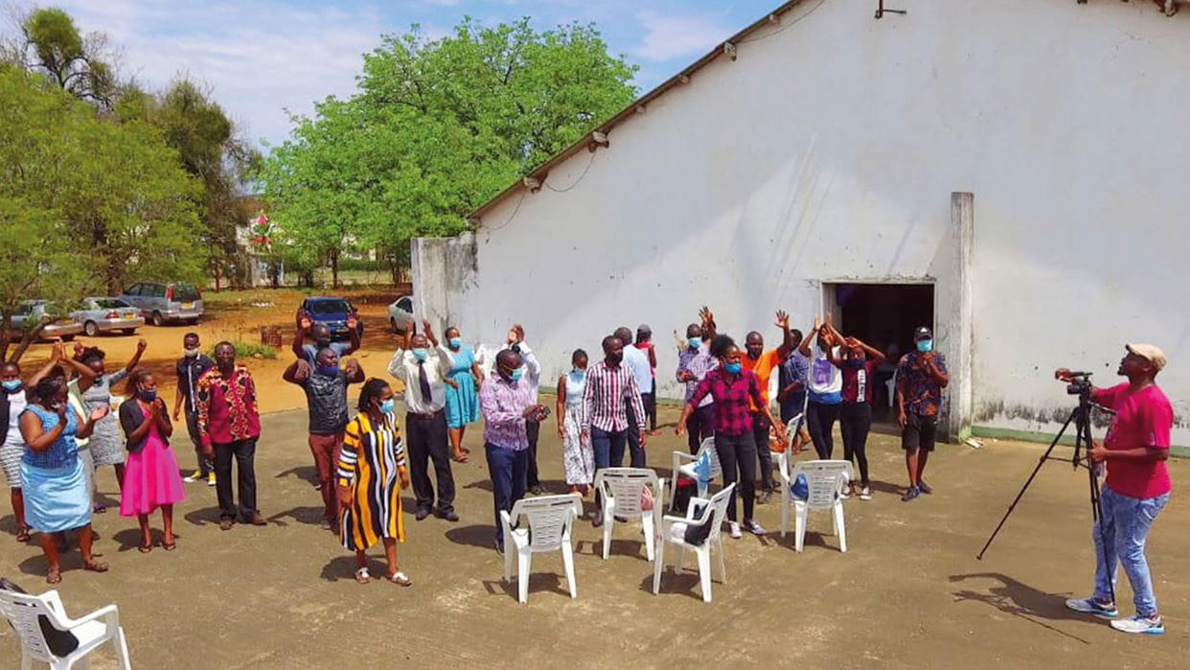
Tool 4: Case study – Zimbabwe
Community champions
Video
Notes:
Could be read out by the trainer or read individually by participants as a break from listening?

Slide 79
Using the tool: Testing the template
Facilitators group prepare for community meeting
Read the case study to understand the community context
Read through the tool to understand the requirements and simplify the information in the tool, if necessary.
Agree on how the community meeting will be conducted
Different members should take turns to lead the community meeting
Church and community group
Read the case study to understand the community context
Outline the issues identified in the case study
Assign various roles found in the community to the group members
Notes:
Note to facilitator: The testing of the template can be done through role play with two (2) main roles, the Facilitators group and the Church & Community group. Depending on the number of participants, each group must have between 3 to 6 people. Hand out copies of the participatory planning template to the Facilitator group and copies of the case study to the Church and Community group.
You will need:
Printouts of the template
Printouts of the case study - available in 4 TF core languages

Slide 80
Using the tool: Testing the template
Feedback session
Feedback from the audience
What did you like about the role-play?
What can be improved?
Church and community group
How did you find the exercise?
Anything the facilitators could have done differently to help you as a group?
Facilitators group
How did you find your role?
Anything that was challenging to do?
Everyone
How would you go about facilitating this session if your community cannot read? Give some ideas from your experiences.
Notes:
Note to facilitator: This reflection session will help you see if the participants are understanding the material. Extra resources have been provided in the Guide under “Further Guidance” that facilitators can use as they do their background reading and research

Slide 81
Further guidance
Conduct some background work to get a basic understanding of the local socio-political governance context.
Ensure the community has clearly identified the service delivery issue they would like to address.
Do some basic research on who has the responsibility to deliver the identified service.
Establish what the minimum expected level of service delivery is.
Take some time to think ahead around what advocacy and actions will need to take place to follow up on commitments made towards improving the service delivery.

Slide 82
Further reading
Example 1: Community Score Card for Mafanikio Dispensary, Kufikia County 4 2 2 1
Participatory Budgeting, Community Score Card, Citizen Report Card Toolkit, IEA, 2015, p42
Community scorecard implementation Steps
Social Accountability Topic Guide
Advocacy and social accountability toolbox
Manual on Social Accountability for Civil Society Organizations and Municipalities in Palestine
Community scorecard training guide, pp12–19
Community scorecard slides, pp12–26

Slide 83
Public expenditure tracking survey tool
Tool 5

Slide 84
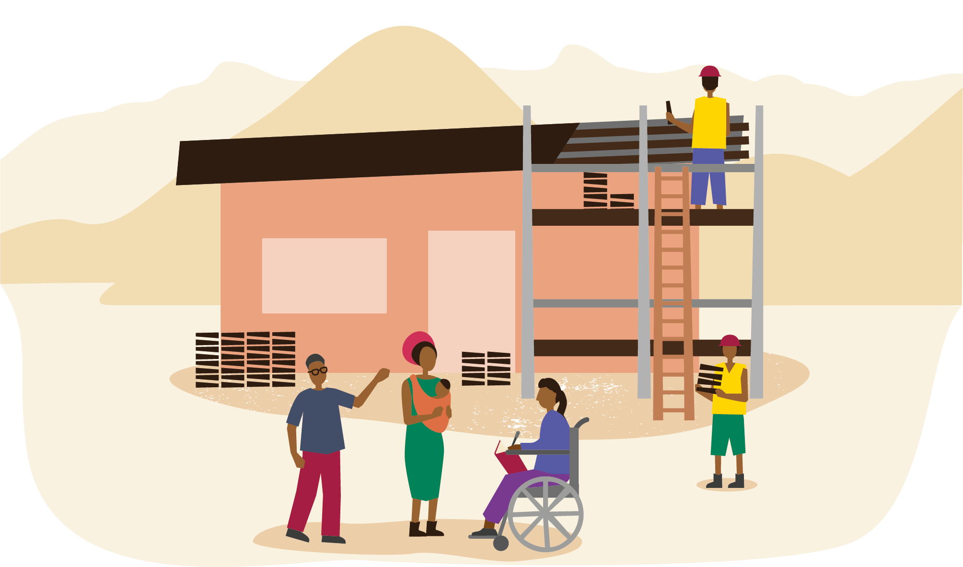
Tool 5: What is the public expenditure tracking survey tool?
This is a method by which citizens track the flow of public resources (eg finances, materials, machinery, human resources) from the highest levels of government, through administrative structures at different levels, all the way to the frontline public service providers.

Slide 85
Tool 5: Purpose
For citizens to assess the amount of funds allocated for implementation of activities by frontline service providers.
Establish how much has been spent,
is being spent
and the outputs that have been achieved through the funds that have already been spent.
This tool can be used at all levels of government where allocation and expenditure of funds take place.

Slide 86
Tool 5: Strengths and limitations
Strengths
Good at keeping up to date with what citizens are concerned about.
Able to focus accountability on local issues as well as wider systemic ones.
Fights corruption and inefficiencies in service delivery.
Limitations
There can be problems if data does not exist, is not accessible, or is in an unusable format, whether intentionally or not.

Slide 87
Tool 5: Public expenditure tracking in your CCT process
CCT approach | CCMP | Umoja/Parivartan/Unidos | Sangsangai
Notes:
Note to Facilitator: Create groups based on the CCT process the participants use. If they use one common process, agree on the stages in the CCT process before assigning people to groups to set out how they go about the planning process and how the issues to focus on as a church and community are agreed upon.

Slide 88
Tool 5: Public expenditure tracking in your CCT process (summary)
This tool is ideal for use at the stage where resource mapping has been done: communities, with the church, have conducted their needs assessment, identified the problems and opportunities in their communities, prioritised the problems they want to focus on and have begun to mobilise resources to address those problems. If the government has already prioritised an identified problem, this tool can be used to ensure that problem is addressed in the best way possible with the available resources. This tool will help the community track how those funds are being used.
CCT approach | CCMP | Umoja/Parivartan/Unidos | Sangsangai
When public expenditure tracking tool can be introduced | Stage 4: Information analysis Stage 5: Decision making | Stage 3: Dreaming dreams and taking action (planning for action) Stage 4: Taking action | 3rd cycle: The community

Slide 89
Tool 5: Key steps in a public expenditure tracking survey
Analyse all of the information
4. Agree on the issue/project to monitor
6. Find out what is actually happening
2. Feedback to your community and those responsible for the budget and its use
5. Form a public expenditure tracking (PETS) team
7. Build relationships
3. Conduct background research
8. Gather the public expenditure information you need
Notes:
Guidance for activity: Split the participants into groups, giving each group a full set of the steps above. Get the groups to put the key steps in the correct order. If you would like to add in a game/competitive element ask the groups to do this in the shortest possible time.
What you will need:
Printed or written pieces of paper with the different steps on them - a full set for each group

Slide 90
Tool 5: Key steps in a public expenditure tracking survey
Form a public expenditure tracking (PETS) team
Build relationships (Should be mainstreamed)
Agree on the issue/project to monitor
Background research
Gather the public expenditure information you need
Find out what is actually happening
Analyse all of the information
Feedback to your community and those responsible for the budget
Notes:
Further information for facilitator:
Form a public expenditure tracking (PETS) team: If possible, the team should be elected by the community. Teams vary in size, but usually have between nine and 14 members. It should include women and men, and people of different ages, ethnic groups and status within the community.
Background research: Try to find out what laws and policies there are in your country relating to expenditure transparency. For example, there may be laws that say people are free to access information regarding public expenditure.
Build relationships: It is very important to try to build relationships with people in the relevant government department or local authority, and with community leaders.
Agree on the issue/project to monitor based on the priorities set during the CCT problem identification and prioritisation exercise.
Gather the public expenditure information you need. Try to get hold of the local authority plans, budgets and expenditure information that you need. Once you have received all the documents, read them carefully. Don’t worry if you have questions about things that you don’t understand – it is fine to ask the people in the office or authority that provided the budget.
Find out what is actually happening: Are the funds for the project being spent as they should be?
Analyse all of the information – does it all add up when you look at the amounts allocated, amounts spent and the progress made?
Feedback to your community and those responsible for the budget and its use, and decide on how to follow up. Collect all your information, analyse it, set it out in a report and hold a community meeting to make sure everyone has the opportunity to hear your findings, and to be involved in any follow up.

Slide 91
Tool 5: Case study – Uganda
Advocacy in Uganda: Building relationships with local government

Slide 92
Using the tool: Testing the template
Facilitators group prepare for community meeting
Read the case study to understand the community context
Read through the tool to understand the requirements and simplify the information in the tool, if necessary.
Agree on how the community meeting will be conducted
Different members should take turns to lead the community meeting
Church and community group
Read the case study to understand the community context
Outline the issues identified in the case study
Assign various roles found in the community to the group members
Notes:
Note to facilitator: The testing of the template can be done through role play with two (2) main roles, the Facilitators group and the Church & Community group. Depending on the number of participants, each group must have between 3 to 6 people. Hand out copies of the participatory planning template to the Facilitator group and copies of the case study to the Church and Community group.
You will need:
Printouts of the template
Printouts of the case study - available in 4 TF core languages

Slide 93
Using the tool: Testing the template
Feedback session
Feedback from the audience
What did you like about the role-play?
What can be improved?
Church and community group
How did you find the exercise?
Anything the facilitators could have done differently to help you as a group?
Facilitators group
How did you find your role?
Anything that was challenging to do?
Everyone
How would you go about facilitating this session if your community cannot read? Give some ideas from your experiences
Notes:
Note to facilitator: This reflection session will help you see if the participants are understanding the material. Extra resources have been provided in the Guide under “Further Guidance” that facilitators can use as they do their background reading and research

Slide 94
Further guidance
As you plan to support the specific church and community to use this tool, you need to do some background work to get a basic understanding of the country’s local and national expenditure cycle to build your confidence on the subject.
Then do a similar exercise with the community and together acquire a more detailed understanding of the expenditure framework locally.
Key questions to be answered:
When are budgets approved in the country at local and national level?
What form of government is in place? Is it centralised or decentralised?
What resources are sent to the local level, when, how often?
What routes are available to access expenditure information?
What are the key dates for disbursements, expenditure and reporting?

Slide 95
Further reading
PETS slides pg 28–39
PETS training guide pg 20–27
Detailed PETS guidebook

Slide 96
Social audit tool
Tool 6

Slide 97
Tool 6: What is the social audit tool?
This tool should not be confused with financial or operational audits.
It has a broader scope than citizen report cards or community scorecards.
It collects evidence from various stakeholders to provide accurate feedback on all stages of the outworking of government policy, including financial management, access to information, and participation.

Slide 98
Tool 6: Purpose
To provide accurate feedback to service providers and communities on the level of achievement and areas of improvement in service provision. This tool supports the prevention of corruption by:
potentially exposing it
informing the public about the possible impacts
of public policies
bolstering citizens to voice needs and make demands of their government
measuring consistency between policy or programme promises and results
This tool can be used at all levels of government. It can range from a specific local project, to a government department, to a multiple national programme.

Slide 99
Tool 6: Strengths and limitations
Strengths
Supports citizens’ awareness of government policies, programmes and projects and connects this to the impact on them.
Clarifies the relevance and impact of government policies and programmes.
Increases government transparency and efficiency in delivering programmes and implementing policies.
Limitations
Requires willingness of all stakeholders to conduct all phases of the process.
It is more effective when there is legal protection for the right to information.

Slide 100
Tool 6: Social audits in your CCT process
CCT approach | CCMP | Umoja/Parivartan/Unidos | Sangsangai
Notes:
Note to Facilitator: Create groups based on the CCT process the participants use. If they use one common process, agree on the stages in the CCT process before assigning people to groups to set out how they go about the planning process and how the issues to focus on as a church and community are agreed upon.

Slide 101
Tool 6: Social audits in your CCT process (summary)
This tool is ideal for use at the stage where resource mapping has been done:
communities, with the church, have conducted their needs assessment,
identified the problems and opportunities in their communities, prioritised the problems they want to focus on and have begun to mobilise resources to address those problems.
If the government is already implementing a project to address an issue identified and prioritised by the community, this tool can be used to ensure the problem is addressed in the best way possible to bring about the intended outcome. This tool will help the community establish if the activities, projects or programmes are achieving positive results.
CCT approach | CCMP | Umoja/Parivartan/Unidos | Sangsangai
When social audit tool can be introduced | Stage 4: Information analysis Stage 5: Decision making | Stage 3: Dreaming dreams and taking action (planning for action) Stage 4: Taking action Stage 5: Evaluation | 3rd cycle: The community

Slide 102
Tool 6: Key steps in a social audit tool
Step 1: Identification of the problem
Step 2: Identification of relevant information
Step 3: Procurement of information
Step 4: Accessing the information
Step 5: Scrutiny of information
Step 6: Audit of information
Step 7: Public hearing
Notes:
Further information for facilitators:
Step 1: Identification of the problem
The first step is identifying the specific problems that people face in their interaction with the public service/authority as highlighted and prioritised during the problem analysis in the CCT process.
Step 2: Identification of relevant information
This is much easier if the country has a right to information (RTI) law or an open data collection culture, which is essential for effective participatory budgeting and accountability. The rules and procedures that public officials must abide by, and facts and data relevant to specific problems that need to be addressed, must be kept in mind while seeking information.
Access budgets, plans and policies: Social audits are an instrument to compare how a government programme or service is working on the ground against how it should be working according to the government/project objectives, budgets, documentation, policies and reports.
Compare the actual expenditure against budgets.
Evaluate the quality and experiences of services/programmes provided by the government.
Step 3: Procurement of information
Find out whether the right categories of information are being generated, by whom and where they can be accessed.
Develop a list of questions to guide citizen monitoring. In order to collect the correct information, participants must develop a list of questions that will give them the answers they are looking for regarding the programme/service they are auditing. This is set out in the social audit tool, viewed below.
Train participants, residents and/or the community on the methods. The exercise is carried out by large groups of people/residents, and it is necessary to train them. Participants are trained to help them to:
Understand government policy and budget documents.
Learn to collect and understand information during the audit.
Interpret information and formulate questions.
Step 4: Accessing the information
The next step is to access the information required or identified. In several countries, the bureaucracy is extremely secretive about public agency functions and information.
Systematically identify and analyse relevant documents and ensure certified copies of the documents are obtained.
Conduct inspections of documents to help identify the gap between what was budgeted for and what was actually spent. The inspection will seek to answer the questions: ‘Has the money been spent on the right things in the budget?’ ‘Is this the best product we can get at this cost?’
The inspection would require people with the technical expertise and knowledge of local conditions.
Step 5: Scrutiny of information
Collate and simplify the information into an accessible format before individuals and the community go through the documents. Some citizens may not have the technical know-how to understand the original document. At this stage, complicated information obtained from project records should be summarised in a simple format.
Verify the information with the members of the community who are important sources of that knowledge.
The field investigators must have a thorough knowledge about the issue in advance, the problems involved and the manipulation involved in instances of corruption.
Step 6: Audit of information
This step involves facilitating an audit of information for grievance redressal.
After having acquired evidence of the instance of corruption, attempts are made to address the problem and redress the grievances of the people. Two possible options are:
Approach the institutional mechanisms available for grievance redressal with copies of relevant documents.
Citizens can approach forums provided for under the law for facilitating such an audit.
Step 7: Public hearing
This is the most important stage of the social audit, as this is when the collective scrutiny actually takes place. It is the culmination of the social audit process.
The public hearing needs a neutral facilitator to lead the discussions.
The goal is not to publicly shame people, but to promote quality service delivery.
Participants or the social audit team present their findings to local authorities and to the broader community. These public hearings allow the community to talk about their experiences of the programme/service under audit.
Local authorities have an opportunity to listen to the findings of the community to establish where there are opportunities to make improvements.
Action plans with timelines are created to remedy identified problems.

Slide 103
Tool 6: Case study
A local early-childhood development and education centre was being constructed in a county supported under USAID’s Agile and Harmonised Assistance for Devolved Institutions (AHADI). The community wanted to ensure that this treasured resource would fulfil their needs and expectations of improving their access to quality education in a safe environment. After thorough scrutiny of the project documents, community members unanimously agreed that there was a worrying discrepancy between the building works and the plan. The citizens raised their concerns with the County Early Childhood Development and Education Director and the area Member of County Assembly. The county leadership in turn summoned the contractor to a public meeting to explain the discrepancy. The contractor accepted liability, demolished the defective works and reconstructed the education centre, keeping to the approved design and bill of quantities in the contract. The construction was completed with close supervision from the County Public Works Engineers and the school Board of Management.
Group exercise: If the community wanted to know if the quality of education had improved after a year of using the Education Centre, which social accountability tool(s) could they use and why?

Slide 104
Further guidance
Before you start using the social audit tool with the community:
Ensure you have a good understanding of the CCT approach used in the community where you will use this tool.
Conduct some preliminary research answering the following questions:
Is there a right to information law in place?
Are government institutions willing to share information? If not, some work needs to be done to address this as it will be difficult to conduct social audits without key documents concerning the project earmarked for auditing.

Slide 105
Further reading
Social Accountability Topic Guide
Advocacy and social accountability toolbox
Social Audit: A Toolkit A Guide for Performance Improvement and Outcome Measurement
Manual on Social Accountability for Civil Society Organizations and Municipalities in Palestine
Manual on Social Accountability: Concepts & Tools

